Slide 1
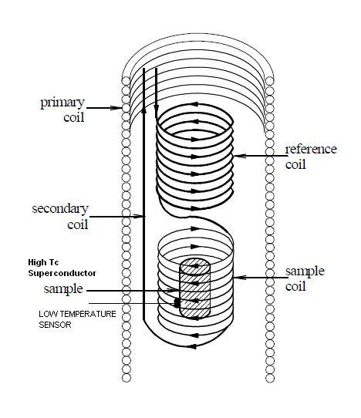
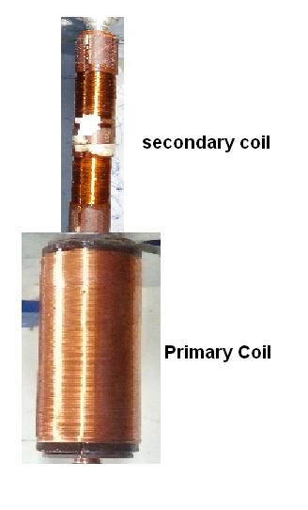
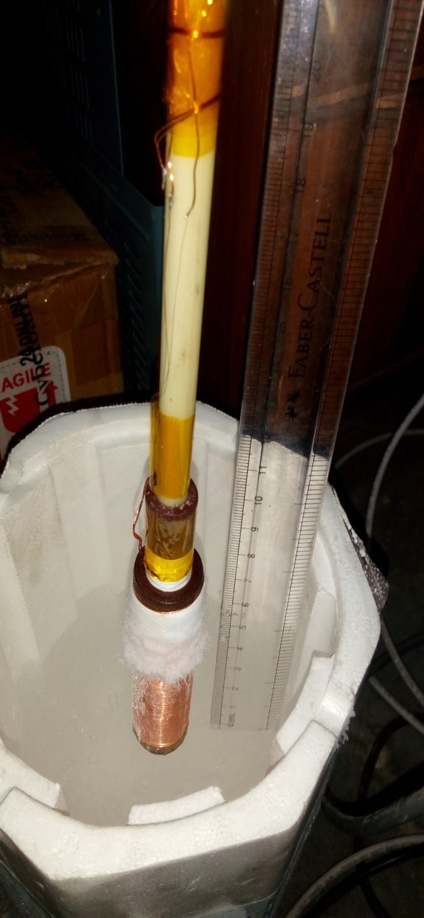
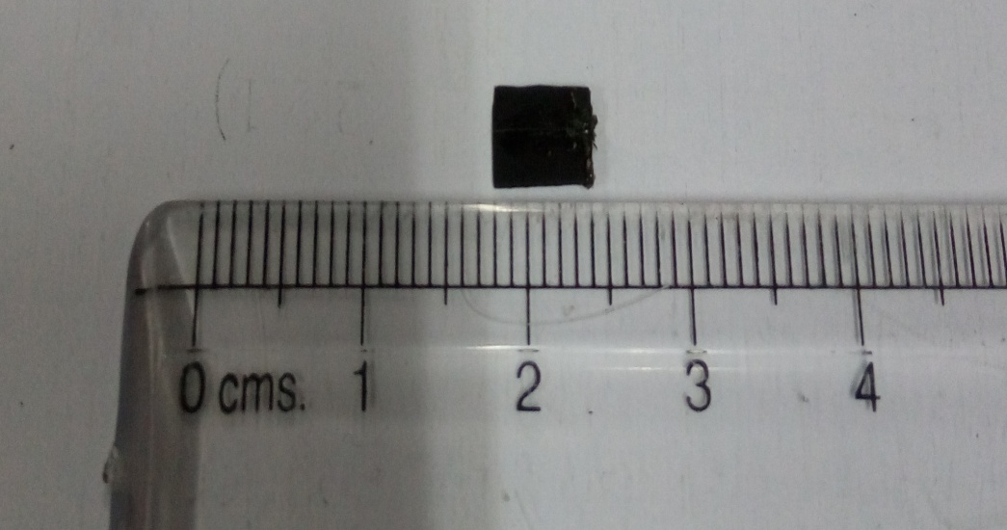
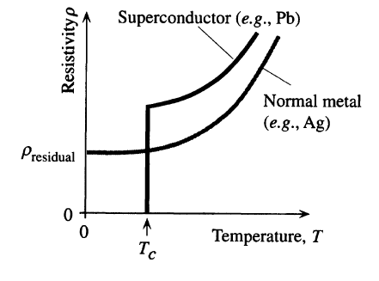
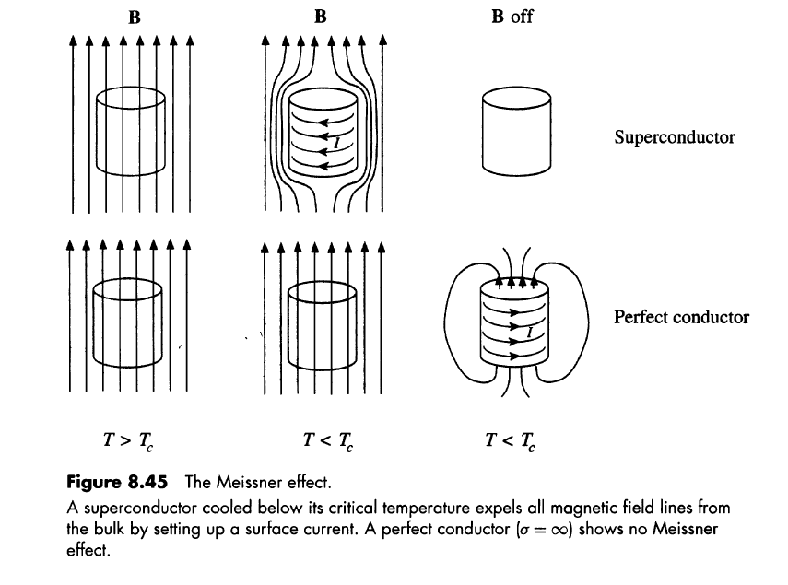

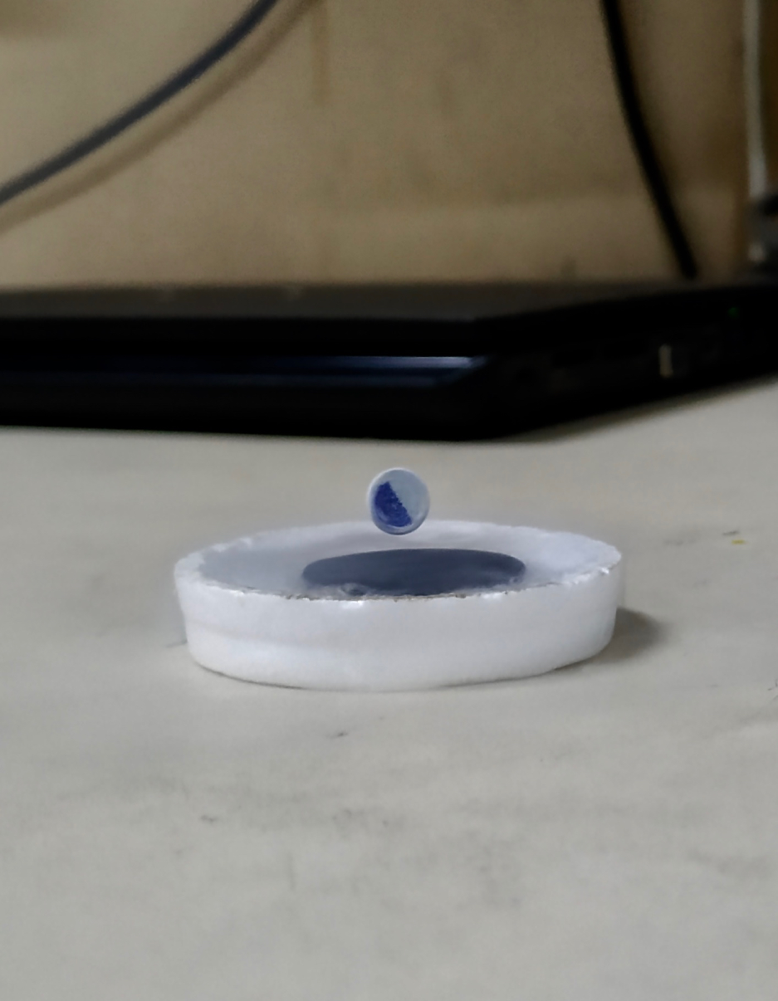
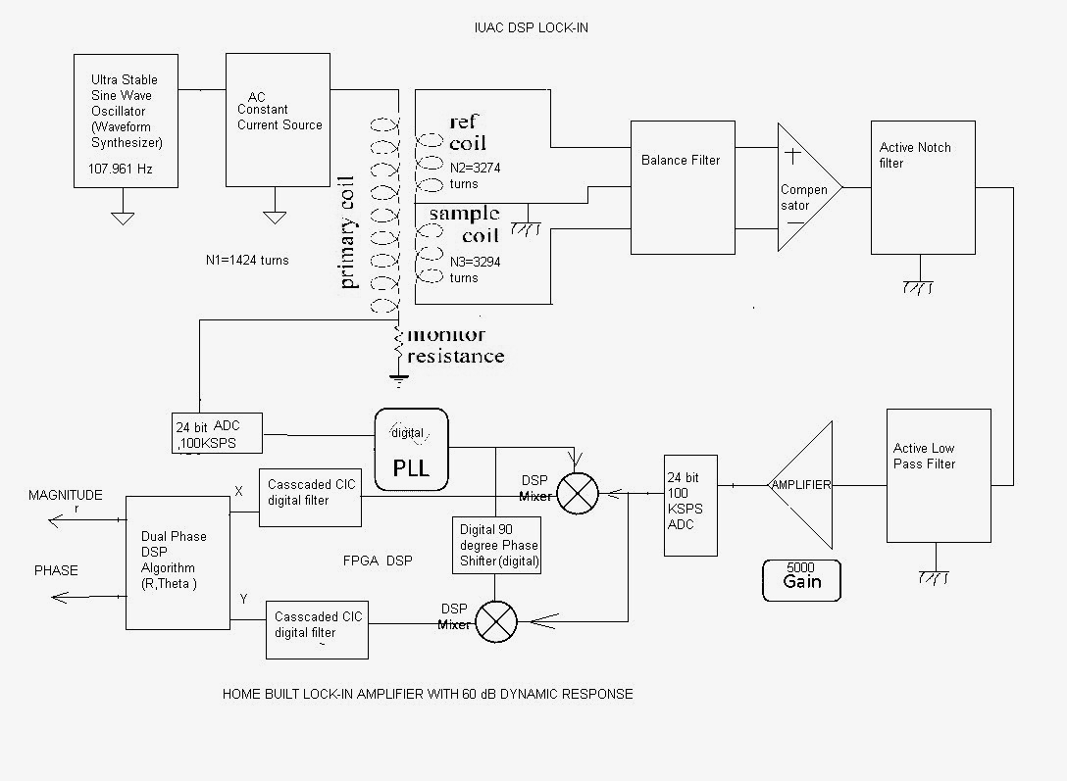
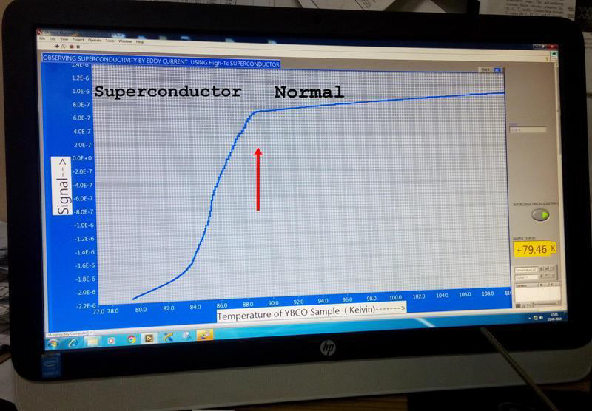
Superconductiviting Transition by using Mutual-inductance coil
Joby , Sumit , Vineet and A.K.Rastogi
HOW Suprerconductor -- Normal state Transition is measured using Mutual-inductance?
An oscillating current in the PRIMARY coil generates a magnetic field flux This flux links to the SECONDARY coil and gives an output voltage by FARADAY LAW of Induction.
Superconductor is a perfect Diamagnet and when placed in the inductor it reduces the flux, changes the flux linkage and thus output voltage
On heating the change in output voltage disappears indicating Transition to the Normal paramagnetic state
For large Sensitivity of measurement we use NULL METHOD for the Output Voltage of the empty Mutual Inductor coil
When a small sample is inserted in the coil only a very little change of 1 in 10⁵ in flux linkage between Primary and Secondary coil occurs.
The corresponding change in the signal voltage is only ~10-100μV, in the presence of large ~10-100mV secondary voltage of the empty coil.
We use Specially wound two secondary coils in series opposition as shown in fig (1) below to NULL the output voltage of the empty coils.
Moreover, our electronic circuit is also used to annul the remaining voltage prior to inserting the sample by using our measuring circuit .
YBCO -Superconductor
Series opposition of Secondary coils
For NULLING output voltage
Actual coils: Primary= 250 turns/cm
Secondary S₁=3270 turns and S₂=3290 turns
Liquid Nitrogen Vessel
Characteristics of a Superconductor
Magnet
Superconductor
Zero Resistance
Meissner Effect
Levitation
Measurement using IUAC made DSP based Lock-in Amplifier
Electronic Compensator and
Duel-Phase DSP–Based Lock –in Amplifier
Plot of secondary voltage versus temperature showing Superconducting Transition
IUAC_FOUNDATION DAY 19 DEC 2018

